Slide 1
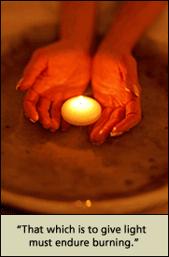

Compassion Fatigue Prevention and Resiliency:
Fitness for the Frontline
Sponsored by:
PESI
Prevention & Resiliency
J. Eric Gentry, PhD, LMHC, CAC
Master Traumatologist
Notes:
Welcome
Narrative
28 years
ARP
Tx

Slide 2
Compassion Fatigue: A Crucible of Transformation
Exercise:
Silent Witness*
The Effects of Our Work
Write down three (3) negative effects from your work as a caregiver on an index card
For two minutes circulate about the group allowing others to see your card
*Adapted from Saakvitne, Gamble, Pearlman, & Lev (2000). Risking Connection: A Training Curriculum for Working with Survivors of Childhood Abuse. Sidran Press.

Slide 3
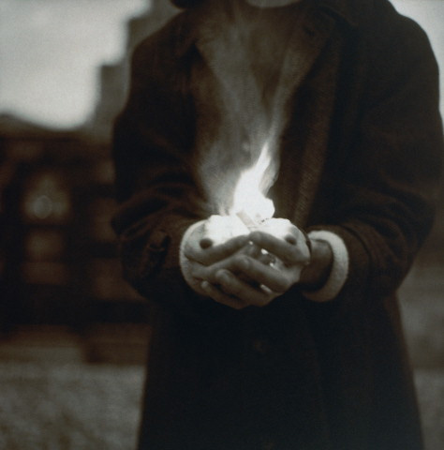
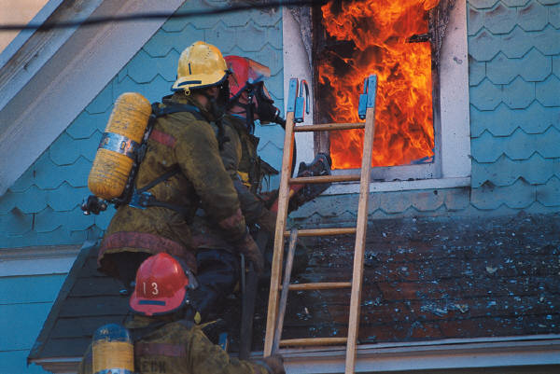




Compassion Fatigue
“That which is to give light
Must endure burning”
- Viktor Frankl

Slide 4

Compassion Fatigue
S T R E S S !!!
Is your job stressful?
If so, what are some of the causes?
What are some of the effects?

Slide 5

Compassion Fatigue
The Problem

Slide 6
Compassion Fatigue
S T R E S S !!!
Is your job stressful?
If so, what are some of the causes?
What are some of the effects?

Slide 7
Cause & Effect
Causes |  | Effects

Slide 8









Are You 100% Safe Right Now?

Slide 9
Perceived Threat
Physiological | Brain Mechanics | Other Effects
▲Heart Rate | ▲ Basal Ganglia & Thalamic Fx | ▲Obsession
▲ Breathing Rate | ▼ Neo-cortical Fx | ▲Compulsion
▼ Breathing Volume | ▼Frontal Lobe activity ▼Executive Fx ▼Fine motor control ▼Emotional regulation | ▼ Speed & Agility
Centralized Circulation
▲ Muscle Tension | ▼Temporal Lobe Activity ▼Language (Werneke’s) ▼Speech (Broca’s) | ▼ Strength
▲ Energy | ▼ Anterior Cingulate | Constricted thoughts & behaviors
▲ DIS-EASE |  | Fatigue
Fight
Flight
OR

Slide 10
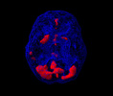
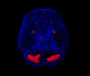
High Anxiety
Increased basal ganglia activity
Stress = Perception of Threat
Normal
Note the lessened activity of the basal ganglia
http://www.amenclinics.com/bp/atlas/ch2.php

Slide 11
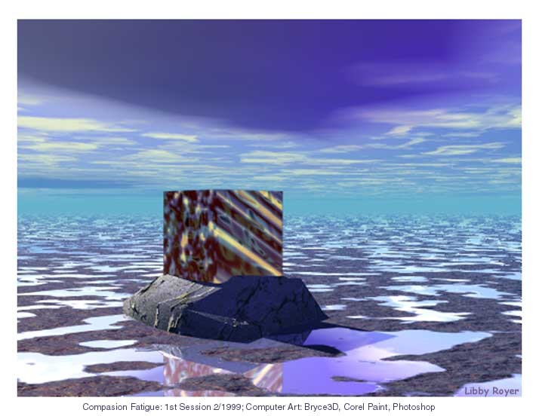
Compassion Fatigue
Secondary Traumatic Stress
Vicarious Traumatization
Burnout
Countertransference
Caregiver Stress

Slide 12
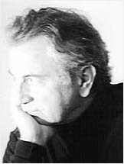
Compassion Fatigue
Compassion Fatigue =
Secondary Traumatization + Burnout
(Figley, 1995)

Slide 13
Compassion Fatigue
“I first called it a form of burnout, a kind of “secondary victimization (Figley, 1983)”
Mimics PTSD and other disorders of clients/patients
Compassion Fatigue = Secondary Traumatization + Burnout (Figley, 1995) Compassion Fatigue: Coping with Secondary Stress Disorder in Those Who Treat the Traumatized. Brunner/Mazel

Slide 14
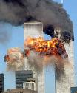
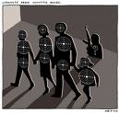


Secondary Traumatic Stress
We are the Safest and Most Frightened Generation in History of Humankind

Slide 15
Secondary Traumatic Stress Symptoms
Arousal (Criterion D) |  | Avoidance (Criterion C)
Fear/Anxiety | Compulsive Behavior | Procrastination | Dread
Obsessive Thoughts | Poor Concentration | Depression | Hopeless
Sleep Problems | Weight +/- | Self Rx | Constriction
Irritability/easily angered | Somatization (HA; Digestive; Hypertension) | Relational problems | Diminishing Self-care activities
Impulsive | Immune Problems | Isolation | Rumination
Dis-ease |  | Blame | Entitlement
Increased Perceived Threats |  | Chronic Fatigue

Slide 16
Secondary Traumatic Stress (STS)
STS vs. PTSD
Criterion A: Event. …witnessing or gaining knowledge of event…learning about unexpected or violent death, serious harm, or threat of death or injury experienced by a family member or other close associate” DSM-IV
Criterion B: Intrusion. Intrusive thoughts of clients, client’s imagery, dreams, increased perceived threat in ALL contexts.

Slide 17

Healing Compassion Fatigue

Slide 18



Healing Traumatic Stress
Secondary & Primary
Narrative
Relaxation
Relationship

Slide 19
Healing Compassion Fatigue:
Secondary Traumatic Stress
Relaxation – PERCEIVED THREAT; when listening to clients; when remembering experiences
Building & Maintaining Relationships – getting support; allowing others to confront when symptomatic; telling on ourselves when we breach integrity; accountability
Sharing Narratives – painful work experiences (with clients and co-workers)

Slide 20
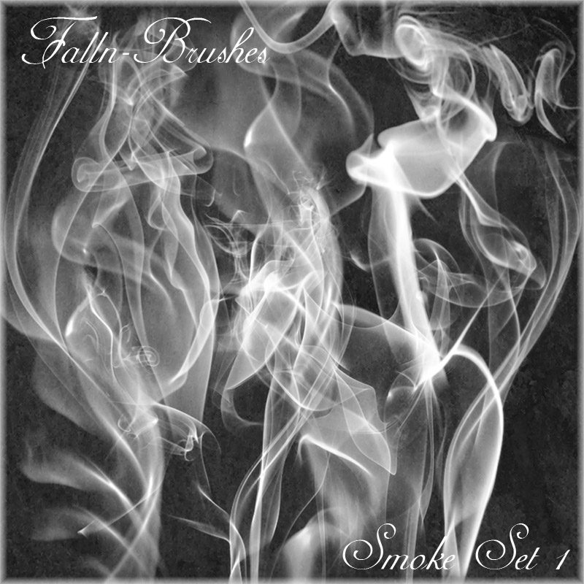
Burnout

Slide 21
Burnout
“Burnout is a psychological syndrome of emotional exhaustion, depersonalization and reduced personal accomplishment”
(Maslach & Goldberg, 1998; 2003)

Slide 22
Burnout
“The chronic condition of perceived demands outweighing
perceived resources”
- Gentry & Baranowsky, 1998
Perceived Threat = Fight/Flight = Sympathetic Dominance = Chronic Anxious presence = Burnout

Slide 23
Burnout: Cause & Cure
PERCEIVED THREAT
Perceived Demands
+
Perceived Resources
=
Perceived Threat = Fight/Flight =
Sympathetic Dominance = Chronic Anxiety = Burnout

Slide 24
Healing Compassion Fatigue

Slide 25


Healing Compassion Fatigue:
From Burnout to BurnThru
+
Relaxation/Self-regulation
(in the context of perceived demand/threat)
Changing Perceptions
When the Pain of staying the Same is greater than the Fear of Change
We will Change

Slide 26
From Burnout to BurnThru:
Correcting Perception
The outcomes of your work are none of your business
Because you are a (professional) caregiver You are entitled to nothing beyond the opportunity to engage your covenant and practice your principles
Your workplace is for practicing your Covenant and your Code of Honor. Period.
Your workplace is always going to demand more from you than you can give…and never be satisfied with what you offer.

Slide 27

Compassion Fatigue Resiliency
The Solution
Professional Maturation

Slide 28




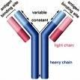
Disease
Disease is the absence of
EFFECTIVE ANTIBODIES
Not the presence of a
TOXIC ENVIRONMENT

Slide 29
Compassion Fatigue “Antibodies”
Self-regulation – ability to immediately shift from sympathetic to parasympathetic dominance (especially when perceiving threat)
Intentionality – Principle-based vs. demand driven; fealty to covenant
Perceptual Maturation/Self-validation – other’s reaction and valuation do not determine behavior; integrity > reputation
Connection – develop and utilize support network
Self-care – aerobic activity (3x/week) primary
Primary
Secondary

Slide 30

Antibody II: Intentionality

Slide 31
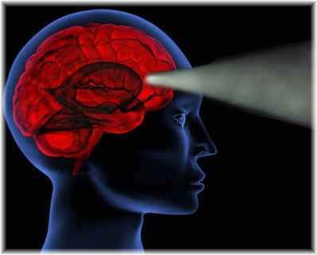
Compassion Fatigue Resiliency
Antibody 2: Intentionality
Do I go where I aim myself?
Requires self-regulation
Mission-driven
Internal locus of control
Principle-based
Tolerance of pain for growth
Maturation of spirituality

Slide 32
Trauma: Thwarting Intention
Worksheet 1
Dreading Clients
Critical of Colleagues
Reactivity
Covenant
Trigger
Vision
Past painful and/or traumatic learning experiences
Compassion
See
Hear
Feel
Taste
Smell
© 2007 Compassion Unlimited

Slide 33
Healing Trauma
With Intentional Living
Dreading Clients
Critical of Colleagues
Reactivity
Covenant
Self-
Regulation
Intentionality
Vision
Trigger
Past painful and/or traumatic learning experiences
Compassion
Compassion
See
Hear
Feel
Taste
Smell
© 2007 Compassion Unlimited

Slide 34
Formula for Hope #2
Intention into Words
+ RELAXATION
= Comfort in Body
= Increased Thinking Capacity
= Living with Intentionality & Integrity

Slide 35


Antibody I: Self Regulation
Chill
Developing “bodyfull-ness”

Slide 36
Antibody 1: Self-Regulation
No Clenching

Slide 37
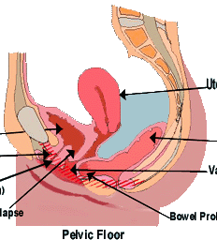
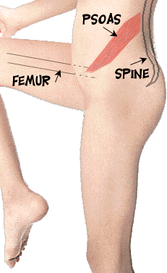
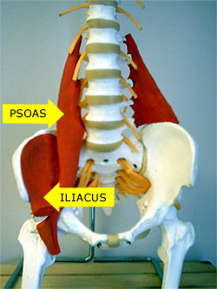
Self-Regulation
Relaxing tension of pelvic floor muscles switches from sympathetic to parasympathetic dominance
Psoas, Sphincter, and Kegels (anterior + posterior)
Regaining of neocortical functioning in 20-30 seconds
Relieves pressure on vagus nerve
Impossible to experience stress – comfortable in one’s own skin
B. Scaer (2006)
NIMH (2004)
D. Bercelli (2003)
R. Sapulsky (1999)
Porges (1999)

Slide 38

Compassion Fatigue Resiliency
Antibody 3: Perceptual Maturation
Choice vs. Demand
Relinquish Outcomes
Caregiving from mission – self-regulation
Resolution of attachment trauma
Resilient to judgment by clients and peers
Often spiritually-based
Sense of potency balanced with humility

Slide 39

Compassion Fatigue Resiliency
Worksheet 3
Connection/Support
Narrative of painful/traumatic work experiences
Empowering select few to confront when symptomatic
Ability to safely “tell on yourself”
Accountability
Authentic “self”
Resolving attachment trauma
Responsibility to “train” support group
Creating community

Slide 40
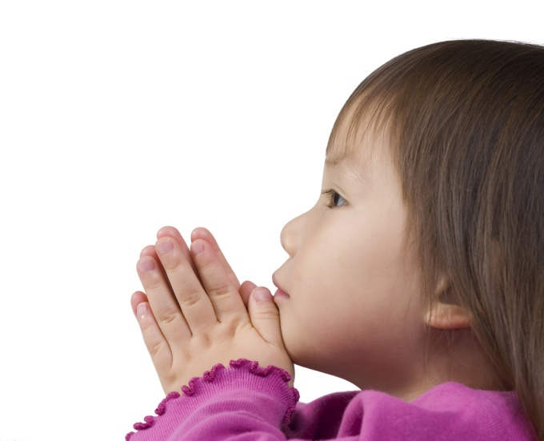








Vaccine V: Self-Care

Slide 41
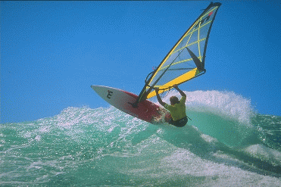
Compassion Fatigue Resiliency
Worksheet 4
Self-Care – “Refueling”
Aerobic activity (3x/week)
Fuel for “enduring burning”
Music/Art/Sport that combines discipline and improvisation
Active instead of passive
Solitude/Spirituality/ Nature
Intentional Plan

Slide 42

Compassion Fatigue Resiliency
Mature & Resilient Caregiving
Worksheet 5
Antibody I: Self-regulation
Antibody II: Intentionality
Antibody III: Self-validation
Antibody IV: Connection/Support
Antibody V: Self-Care (refueling)

Slide 43



Compassion Fatigue Resiliency
Fueling
Incandescence
Perpetual
Illumination

Slide 44

J. Eric Gentry, PhD,LMHC
3205 South Gate Circle #9
Sarasota, FL 34239
(941) 720-0143 V
(941) 827-9454 F
eg@compassionunlimited.com
www.compassionunlimited.com
www.kleenmusic.com

